Slide 1
Investigations into delays in issuing title deeds to beneficiaries of RDP/ BNG housing projects
DHS Titling & Tenure Reform Symposium
Dr Mark Napier
Research Group Leader: Housing & Urban Studies
CSIR Smart Places
25 March 2025

Slide 2
Structure of presentation
1. Quick reminder of why tenure is important
2. How the title deed challenge was identified and tracked
3. Some of the responses to the challenge

Slide 3
Quick reminder of why tenure
is important

Slide 4
The continuum of land rights
Perceived tenure
approaches
Adverse
possession
Occupancy
Leases
Informal land rights
Formal land rights
Customary
Alternatives
to eviction
Group
tenure
Registered
freehold
Continuum of Land Rights (UN Habitat GLTN, 2012)

Slide 5


2013
Understanding and securing tenure and access to land markets
Trading Places
Accessing land in African cities
Napier, Berrisford, Kihato, McGaffin, Royston
Notes:
https://www.ukesa.info/library/view/trading-places2

Slide 6
2. How the title deed challenge
was identified and tracked

Slide 7



2011
Early recognition & measurement

Slide 8
Registrations as a Proportion of Reported Delivery

Slide 9
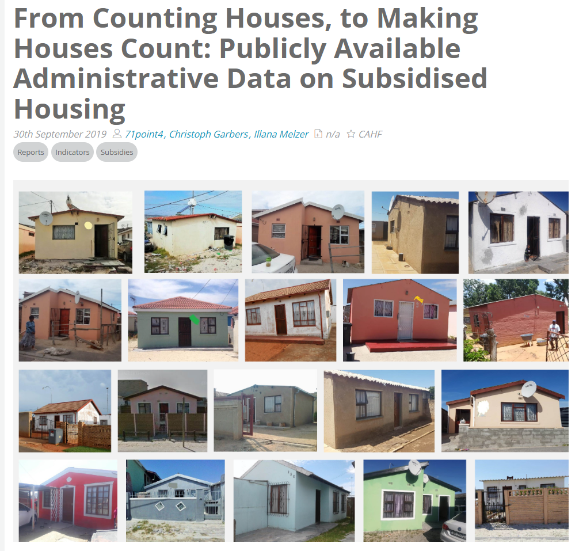


2019
Centre for Affordable Housing Finance continues to track
Notes:
https://housingfinanceafrica.org/documents/from-counting-houses-to-making-houses-count-publicaly-available-administrative-data-on-subsidised-housing/
https://housingfinanceafrica.org/app/uploads/PUBLICLY-AVAILABLE-ADMINISTRATIVE-DATA-ON-SUBSIDISED-HOUSING-FINAL-30-SEPT-2019-CG.pdf

Slide 10
2019
Centre for Affordable Housing Finance continues to track

Slide 11
3. Some of the responses
to the challenge

Slide 12
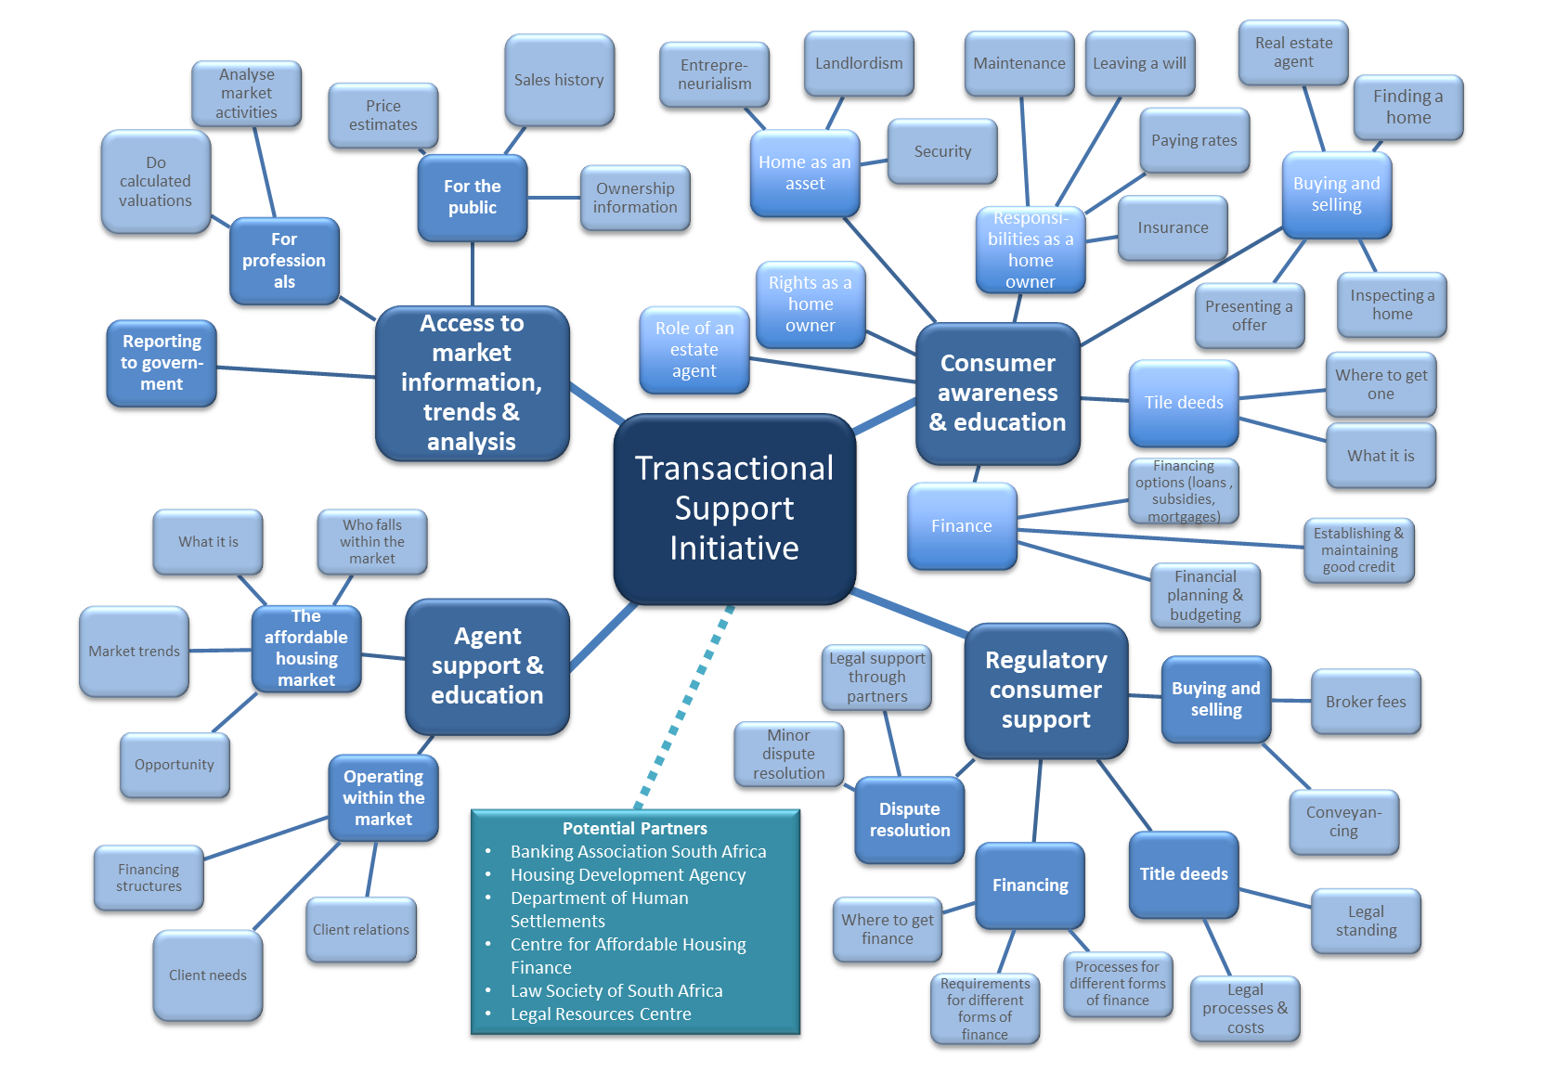
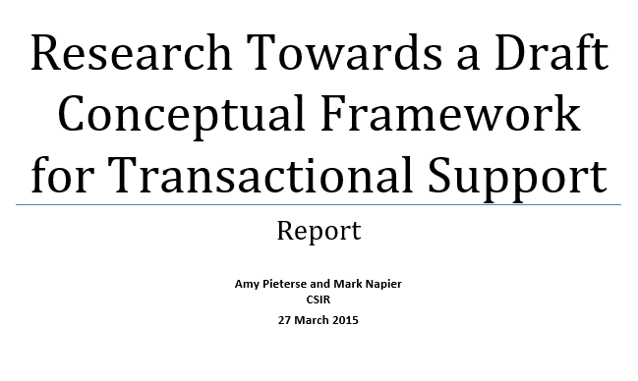
2015
Transaction support – EAAB & CSIR
CSIR report prepared for the Estate Agency Affairs Board of South Africa

Slide 13


2018
Tenure support centre – CAHF and 71point consulting

Slide 14



2004 – 2025
Policy responses
Enhancing access to title – Access to title is a fundamental principle of national housing policy. While security of tenure has been achieved in principle, a significant proportion of public housing stock has not yet been transferred into the names of the entitled individuals

Slide 15
Conclusion
As shown, science councils, universities and research organisations have played an essential role in identifying, tracking and helping to address the challenges
Their role in supporting the implementation of title and tenure reform as outlined in the new White Paper should continue to be central
As new measures to strengthen the tenure system are designed and implemented, these groupings can also make a very important contribution to monitoring, evaluation and learning
A great deal of work has already been done, so build on the past to springboard into the future – knowledge exchange is key

Slide 16

Thank you email: mnapier@csir.co.za
www.ukesa.info

