Slide 1
CADASTARAL SYSTEM AND TRANSFER PROCESSES:
CADASTRAL SURVEYS
By Branch: National Geomatics Management Service (NGMS)
Department of Agriculture, Land Reform and Rural Development
TITLING/TENURE REFORMS SYMPOSIUM-25 March 2025

Slide 2
BRANCH NGMS MANDATE
Everything happens somewhere. This Branch is responsible for position.
The Branch maintains an Integrated Geographical Reference System which is linked to the Global Reference System in order to secure accurate position.
The integrated survey system contributes to speedy orderly development while the mapping and associated products facilitate sustainable development.
The offices of the Surveyors-General process surveys for the approval and safe-keeping of all diagrams, general plans and sectional title schemes used for registration purposes, in the respective provinces.

Slide 3
BRANCH NGMS MANDATE
The great advantage of South Africa's cadastral survey system is that it accurately identifies the position of each parcel of land and the extent of rights over it.
The security of title so provided has long served as a basis for the private sector to finance physical development.
These cadastral surveys ensures integrity of the land parcel information and mitigates against overlapping and conflicting rights in land.
The base datasets produced and maintained by the branch play a key role in land administration in the country, especially for land development and promotion of security of tenure as well as for evidence-based planning.

Slide 4
ENABLING LEGISLATION
The branch operational mandate is derived from the Land Survey Act, Act No.8 of 1997
The establishment, appointment and responsibilities of the Chief Surveyor-General, Chief Director: Surveys and Mapping and the Surveyors-General
The regulation of the surveys of land in the Republic and the manner in which these surveys are conducted

Slide 5
ENABLING LEGISLATION
The branch also administers the Geomatics Profession Act, Act No 19 of 2013
The establishment of the South African Geomatics Council
Transformation of the profession, as well as multisector representation in council in terms of state, private sector, voluntary associations and the interest of the public.
Registration of the Geomatics Practitioners in the fields of Land Surveying, Engineering Surveying, Hydrographic Surveying, Mine Surveying, Photogrammetric Surveying and Geographic Information Science.
www.SAGC.co.za

Slide 6
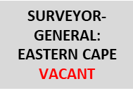
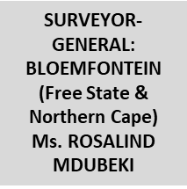
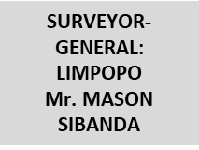
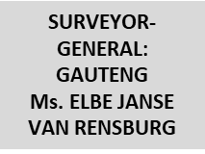
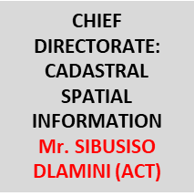
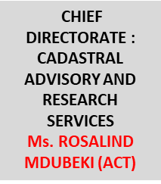
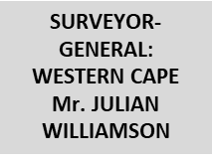
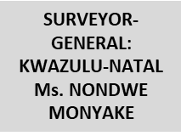
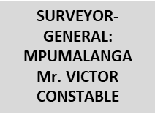
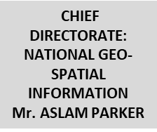
MACRO STRUCTURE

Slide 7
THE CADASTRAL SYSTEM

Slide 8
ROLE OF LAND SURVEYORS
Section 11, LSA
(a) carry out every survey undertaken by him or her in accordance with this Act, and in a manner that will ensure accurate results;
(b) be responsible to the Surveyor-General for the correctness of every survey carried out by him or her or under his or her supervision, and of every general plan or diagram which bears his or her signature;

Slide 9
ROLE OF LAND SURVEYORS
Section 11, LSA
(c) deposit with the Surveyor-General for the purpose of being examined and permanently filed in that Surveyor-General's office such records as may be prescribed in respect of any survey carried out by him or her for the purpose of, or in connection with, any registration of land in a deeds registry, and in respect of any general plan or diagram prepared as a result of that survey, and in respect of any survey carried out by him or her for the replacement of a beacon; and

Slide 10
ROLE OF LAND SURVEYORS
Section 11, LSA
(d) correct without delay, when required by the Surveyor-General, any error in any survey carried out by that land surveyor or in respect of any work related thereto due to failure to comply with this Act and take such steps as may be necessary to ensure the correction of any diagram, general plan and title deed based on the incorrect survey and to adjust the position of any beacon which he or she has placed in accordance with the incorrect survey.

Slide 11
WHO IS A LAND SURVEYOR?
'Professional land surveyor' means a person
(a) who is registered as a geomatics professional in terms section 13(4)(d) of the Geomatics Profession Act (GPA) in the branch of land surveying;
(b) who is authorised to perform work reserved for a professional land surveyor in terms of the Land Survey Act, 1997 (Act No. 8 of 1997); and
(c) whose name is entered in the register for professional land surveyors contemplated in section 8(1)(b)(iii)(bb) of the GPA

Slide 12
WHO IS A LAND SURVEYOR?
'Professional land surveyor’ is responsible for the placing of property beacons in the process of doing the survey and then submit such survey records with the Surveyor-Generals’ office responsible for that area.

Slide 13
BOUNDARY BEACONS
Section 39 - 41 of the Land Survey Act regulates:
a. Manner of erecting beacons for survey purposes
b. Reference marks
c. Maintenance and re-erection of beacons

Slide 14
SURVEYOR-GENERAL OPERATIONS
Examine and approve General Plans, Sectional Plans & Diagrams before any registration is effected in a Deeds Registry
Scan approved documents into electronic format Archive and maintain original documents
Capture newly created land parcels into a spatial dataset
Provide access to existing spatial data
Cancel or amend in accordance with any law any general plan or diagram

Slide 15
SURVEYOR-GENERAL OPERATIONS
Prepare, certify and issue copies of diagrams, general plans and other documents filed in the SG office in the province concerned
Compile and amend such cadastral plans as may be required

Slide 16
DIAGRAM

Slide 17
GENERAL PLAN

Slide 18
SECTIONAL PLAN

Slide 19
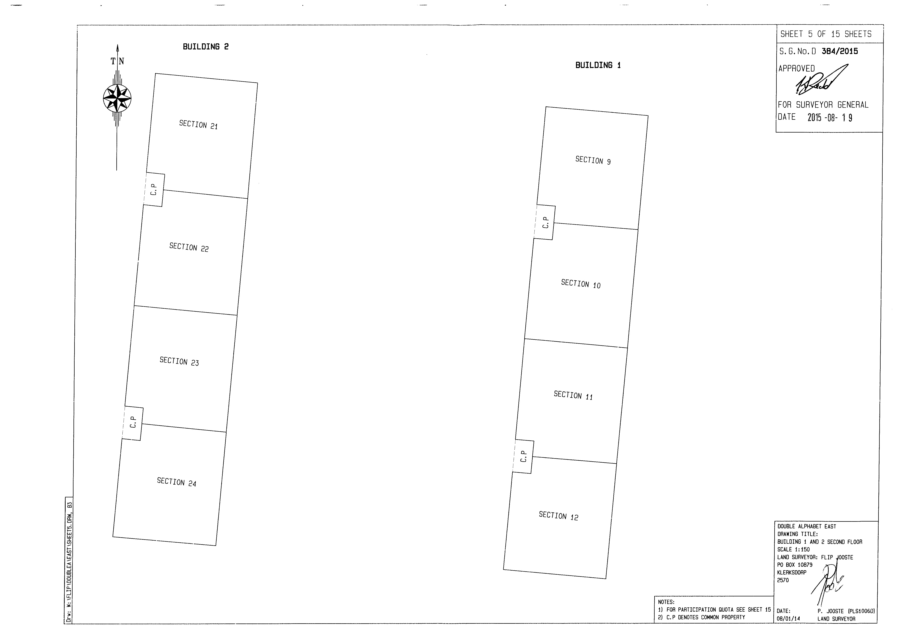
SECTIONAL PLAN

Slide 20
TURN AROUND TIMES
16 working days: the average number of days taken to process cadastral documents (diagrams, sectional plans and general plans) to ensure they comply with all legislative requirements..

Slide 21
PROCEDURE ON EXAMINATION AND APPROVAL OF CADASTRAL DOCUMENTS

Slide 22
FEES OF OFFICE
FEES PUBLISHED IN A GOVERNMENT GAZETTE: NO.2289 PUBLISHED 15 JULY 2022
DIAGRAMS: R425
DRAFT SECTIONAL PLAN: R480 + R70 PER Section, Exclusive Use Area, etc.

Slide 23
FEES OF OFFICE
GENERAL PLAN:
2-50 erven: R1 330 + R80 per erven
51 – 300 erven: R1 765 + R75 per erven
301 – 500 erven: R4 670 + R70 erven
501 and upwards: R6 370 + R90 per erven

Slide 24
CHALLENGES
Removal and destruction of beacons.
Appointment of Non-Professional Land Surveyors to perform Cadastral Surveys.
Non placing of beacons when creating GP
Creation of township on existing occupancy leading to non placement of beacons

Slide 25
WHERE TO FIND SG OFFICES
SG: EASTERN CAPE
Street Adress: 1a Waverly Office Park, 11 Philip Frame Road, Chiselhurst EAST LONDON
Landline: 043 783 1400
Registry email: SGLodgementec@dalrrd.gov.za (THIS EMAIL IS FOR LODGEMENT ONLY)
Information request email: sgdataec@dalrrd.gov.za
General Queries: sgdataec.dalrrd.gov.za

Slide 26
WHERE TO FIND SG OFFICES
SG: MPUMALANGA
Street Adress: 14TH Henshall Street, MBOMBELA
Landline: 013 754 5400
Registry email: SGLodgementmpu@dalrrd.gov.za (THIS EMAIL IS FOR LODGEMENT ONLY)
Information request email: sgdatampu@dalrrd.gov.za
General Queries: sgmpumalangaRegistry@dalrrd.gov.za

Slide 27
WHERE TO FIND SG OFFICES
SG: WESTERN CAPE
Street Adress: 90 Plein Street Cape Town (moving)
Landline: N/A
Registry email: SGLodgementwc@dalrrd.gov.za (THIS EMAIL IS FOR LODGEMENT ONLY)
Information request email: sgdatawc@dalrrd.gov.za
General Queries: sghelpdeskwc@dalrrd.gov.za

Slide 28
WHERE TO FIND SG OFFICES
SG: LIMPOPO
Street Adress: 101 Dorp Street, POLOKWANE
Landline: 015 495 1988
Registry email: SGLodgemenlmp@dalrrd.gov.za (THIS EMAIL IS FOR LODGEMENT ONLY)
Information request email: sgdatalmp@dalrrd.gov.za
General Queries:

Slide 29
WHERE TO FIND SG OFFICES
SG: GAUTENG
Street Adress: 600 Lillian Ngoyi Street, Berea Park, PRETORIA
Landline: 012 303 1601
Registry email: sglodgementsgp@dalrrd.gov.za
Information request email: sgdatagp@dalrrd.gov.za
General Queries: sgquerygp@dalrrd.gov.za

Slide 30
WHERE TO FIND SG OFFICES
3139 Sekame Street
SG: NORTH WEST
Street Adress: 3139 Sekame Street, MMABATHO
Landline: 018 388 7071
Registry email: sglodgementsnw@dalrrd.gov.za
Information request email: sgdatanw@dalrrd.gov.za
General Queries: N/A

Slide 31
WHERE TO FIND SG OFFICES
3139 Sekame Street
SG: KWAZULU-NATAL
Street Adress: 300 Pietermaritz Street, PIETERMARITZBURG
Landline: 033 355 2900
Registry email: sglodgementkzn@dalrrd.gov.za
Information request email: sgdatakzn@dalrrd.gov.za
General Queries: N/A

Slide 32
WHERE TO FIND SG OFFICES
SG: BLOEMFONTEIN (FREE STATE AND NORTHERN CAPE)
Street Adress: 73 Aliwal Street, Omni Building, BLOEMFONTEIN
Landline: 051 448 0955
Registry email: SGLodgemenbfn@dalrrd.gov.za (THIS EMAIL IS FOR LODGEMENT ONLY)
Information request email: sgdatabfn@dalrrd.gov.za
General Queries:

Slide 33
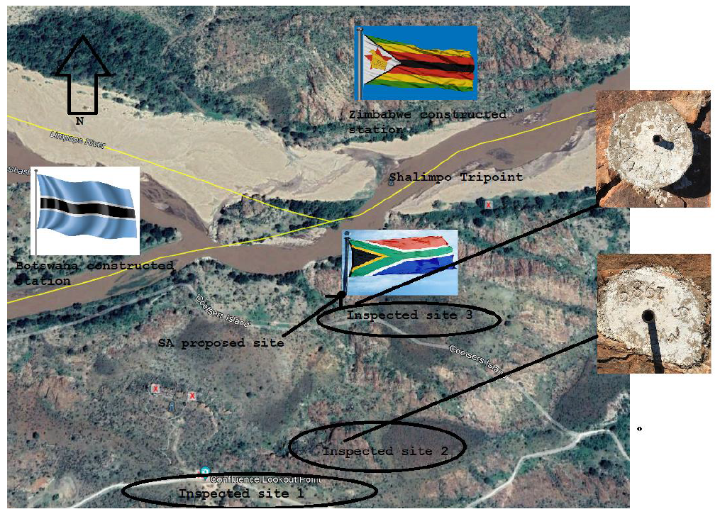
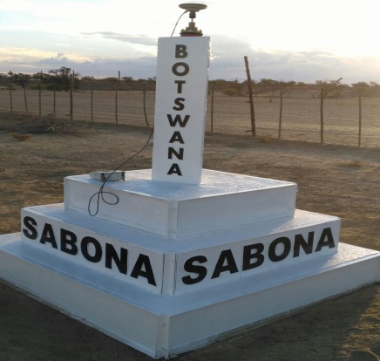
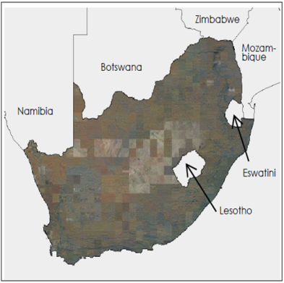
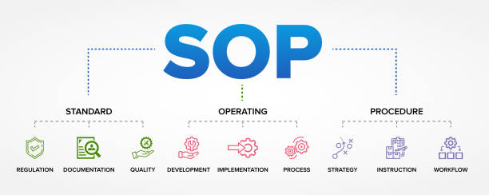
FUNCTIONS PER CHIEF DIRECTORATE/DIRECTORATE
CHIEF DIRECTORATE: CADASTRAL ADVISORY AND RESEARCH SERVICES
The Chief Directorate is based in Pretoria
Manage the registration of sectional titles practitioners
Administer international boundaries
Manage special cadastral services for the state and land reform
Provide internal and external professional advice and support
Undertake cadastral research and development
Prepare technical procedures and standards for cadastral surveys
Limpopo tripoint (Shashe-Limpopo rivers tripoint)
Monument at South Africa-Botswana-Namibia tripoint
The Republic of South Africa with neighbouring States

Slide 34
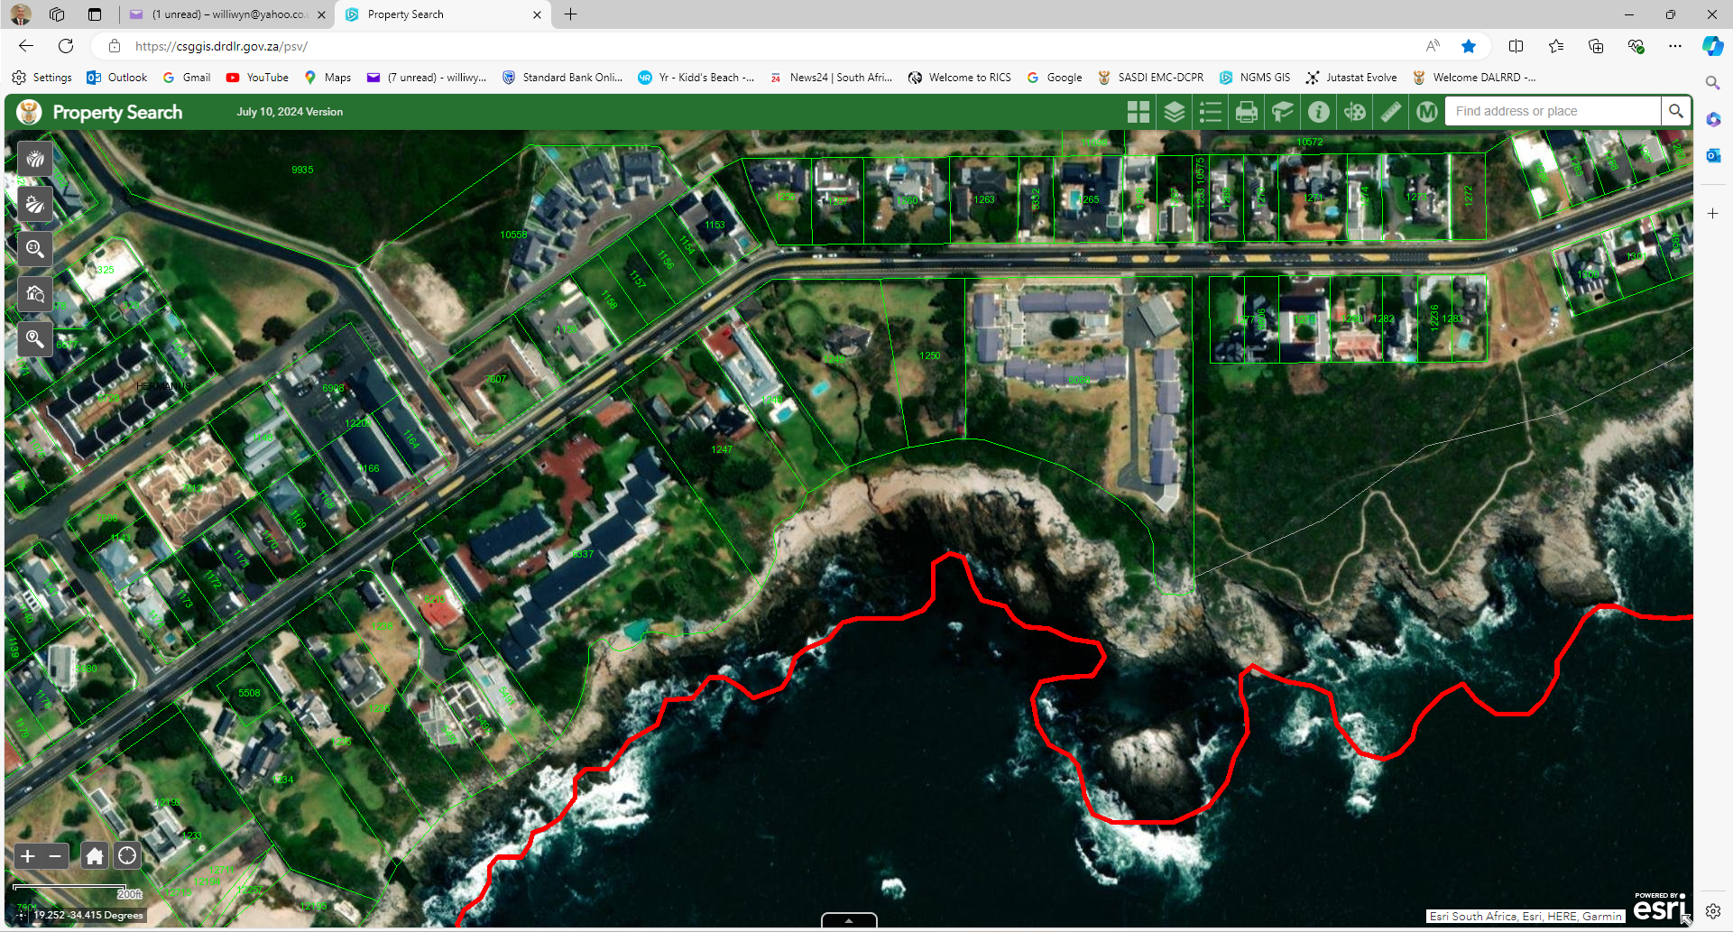
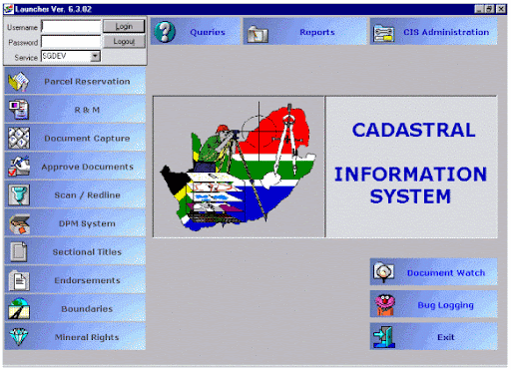
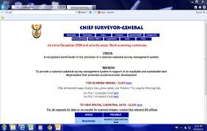
FUNCTIONS PER CHIEF DIRECTORATE/DIRECTORATE
CHIEF DIRECTORATE: CADASTRAL SPATIAL INFORMATION
The Chief Directorate is based in Pretoria
Manage the development and maintenance of cadastral information systems
Provide technological support for the cadastral information system technology
Provide web application support
Manage the national dataset

Slide 36
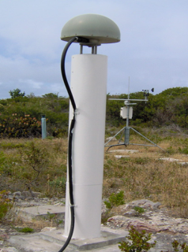
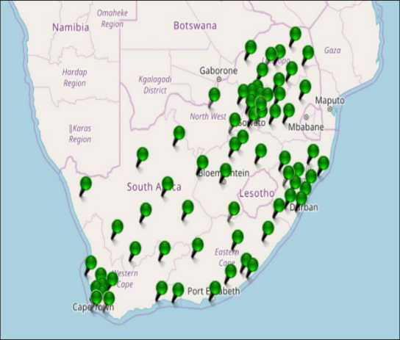
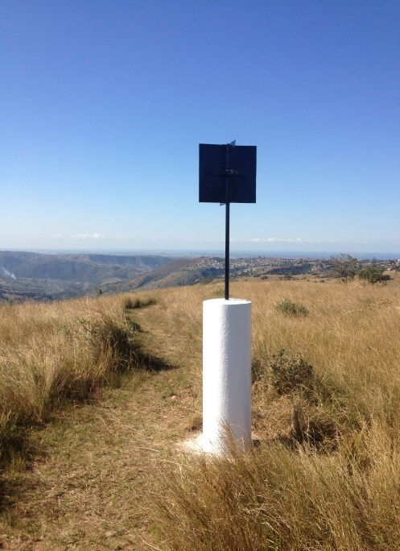
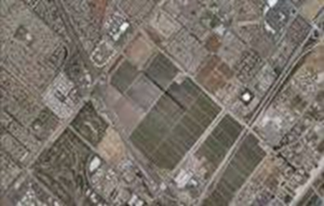
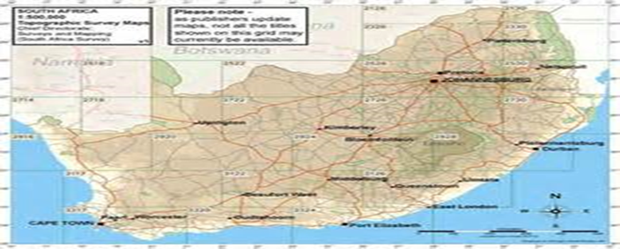
FUNCTIONS PER CHIEF DIRECTORATE
CHIEF DIRECTORATE: SURVEYS AND MAPPING (NATIONAL GEOSPATIAL INFORMATION)
This CD is based in Mowbray, Cape Town and has a national responsibility.
Conduct geodetic, topographical and other relevant
survey operations as may be required;
Acquire aerial photography or other remotely sensed
imagery as may be required;
Establish and maintain a national control survey system;
Prepare, compile and amend such maps and other
cartographic representations of geo-spatial information
as may be required; and
Take charge of and preserve the records
of all geodetic and topographic surveys,
maps and aerial photography or other
remotely sensed imagery.”
A sensor Map showing the distribution of
CORS throughout South Africa

Slide 37
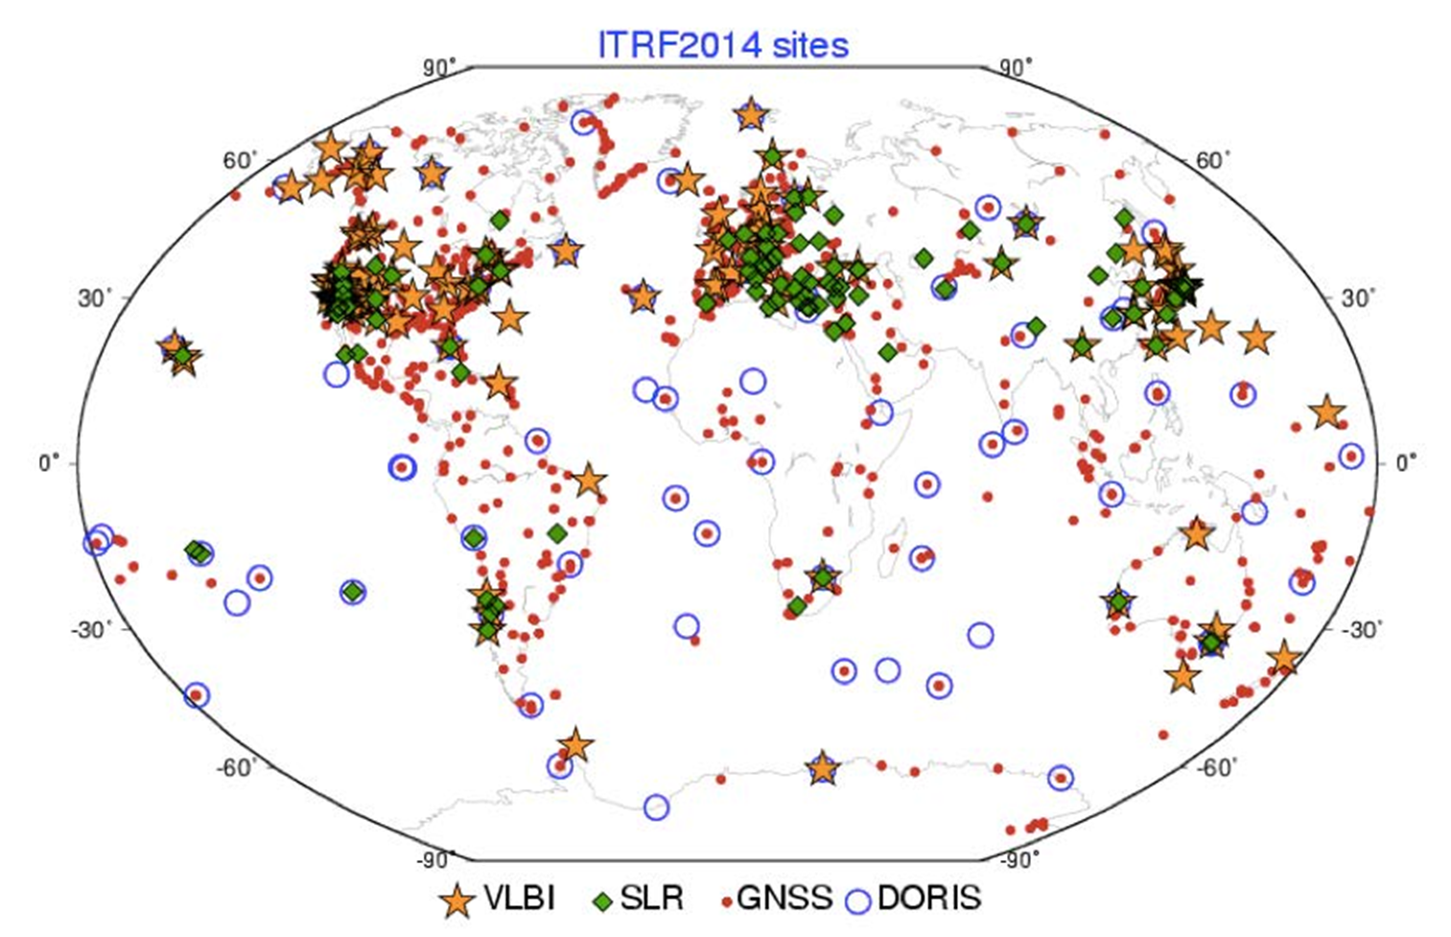
South Africa’s Geodetic links with the International Reference Frame
Branch: National Geomatics Management Service Programme: Office of the Surveyor-General: Eastern Cape
37

Slide 38
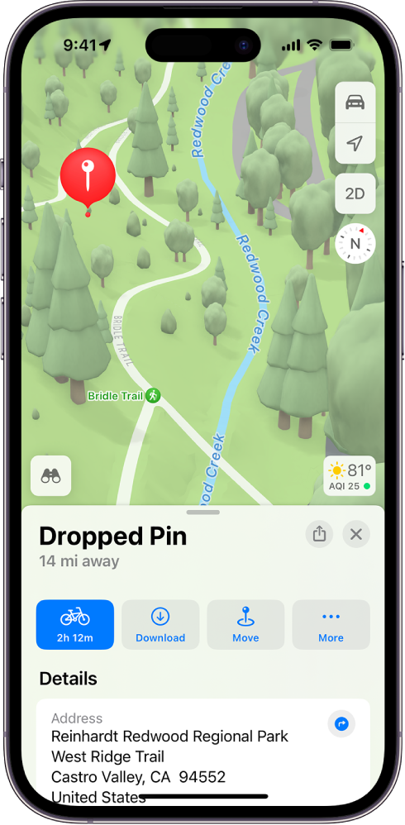
NGIYABONGA
THANK YOU

