Slide 1
BY ZASHE SHOKO FROM THE CITY OF TSHWANE

Slide 2
BASIC REQUIREMENTS FOR LAND DEVELOPMENT APPLICATION
Fees and correct payment referencing
Prescribed documents
Studies that must form part of a township establishment application includes:
Geotechnical report
Traffic Impact Study
Services Report
Noise impact Study
Environmental Impact Assessment
Compliance with advertisement procedure

Slide 3
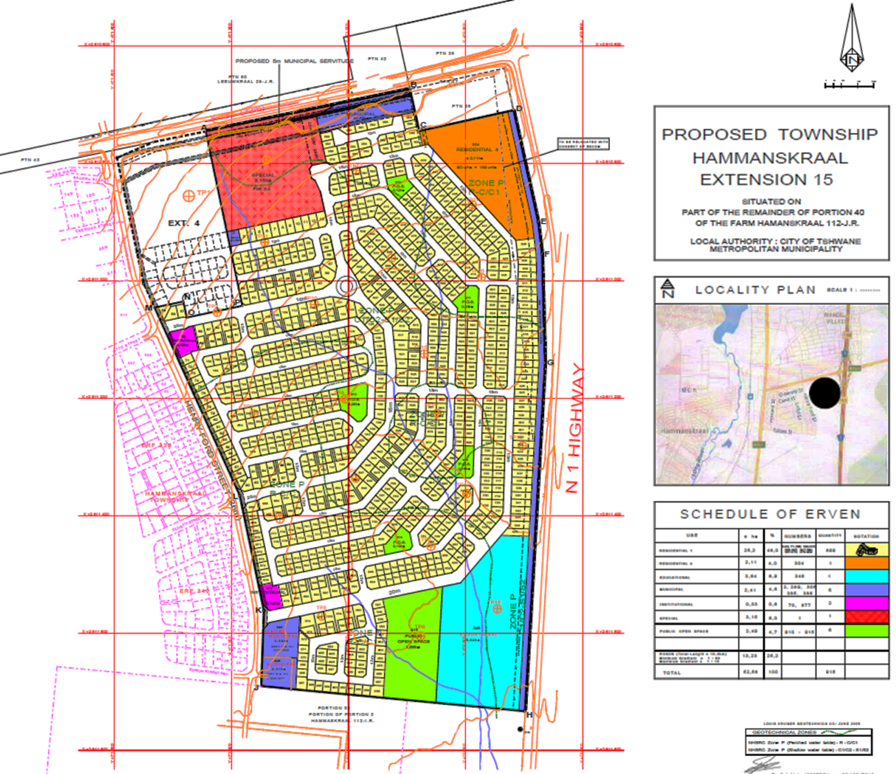
LAND DEVELOPMENT APPLICATIONS
Land : farm portions, agricultural holdings and erf or erven
Township establishment [Section 16(4)] is an application process where agricultural or undeveloped land is converted into a township, involving the creation of streets, erven (plots), and zoning for residential, commercial, or industrial use, following a municipality's planning legislation and policies.
“Rezoning [Section 16(1)] of an erf” means the amendment of the zoning of property(ies) or land as contemplated in a Land Use Scheme;
Subdivision [Section 16(12] of an erf/erven involves splitting a larger land area into smaller, independent units, each with its own title deed.

Slide 4
PROCESS OF A LAND DEVELOPMENT APPLICATION
COMPLETE NEW APPLICATION
An applicant submits an application online and the Deputy Director receives a notification
CIRCULATION STAGE
The responsible FH or PO circulates the application to the internal stakeholders (where external comments are required, the applicant must liaise with external stakeholders and provide those comments to the city).
An administrative evaluation is done when all the required comments are received whether negative or positive (if comment(s) are negative, an A6 letter will be sent to the applicant).
EVALUATION STAGE
When all the comments are positive the application will be referred to the PP for technical evaluation.
When there are objections and all comments are positive, the application will be referred to the PP for technical evaluation and drafting of the MPT
DD allocates the application to the responsible FH or PO together with the PP
The responsible FH or PO conducts an administrative evaluation to check the completeness of the application (i.e., proof of payment and correct referencing).
We await comments from the applicable departments (it is the responsibility of the applicant to follow-up on comments from both internal and external departments. If the applicants experience challenges in their pursuit, they must escalate the matter within specific department).
Administrative rejection occurs when: an application is deemed incomplete.
Additionally, there are available computers at registry in Middestad and Centurion for the viewing and monitoring of comments.
Also, a decision can be issued within a period of 12 months provided all things in order

Slide 5
MUNICIPAL PLANNING TRIBUNAL PROCESS
MPT report is drafted by the responsible planner for the application
MPT is referred to the Deputy Director and Director for signature
The Director forwards the report to the MPT Secretariat scheduling a hearing
MPT Secretariat schedule a date and invite the drafter of the report, the applicant, objectors, required internal and external departments and interested parties (councilors, if applicable)
The matter is heard on the scheduled hearing and the MPT make their decision which is communicated after the approval of the minutes
The party aggrieved by the decision has 21 days to lodge an appeal with the MPT Secretariat to be heard Municipal Appeals Tribunal
MAT can uphold the decision of MPT or overrule it.
If the appellant is grieved by the decision of MAT, they can take it up with the court a for review

Slide 6
APPLICABLES PROCESSES AFTER INITIAL APPROVAL
TOWNSHIP ESTABLISHMENT
Lodging of Layout Plan in terms of Section 16(6) of the Bylaw for approval with the Surveyor-General within 12 months after approval or request extension of time
Compliance with pre-proclamation conditions specified on the approval letter and conditions of establishment including payments of development charges
Issuing of compliance certificates to Survey General and Register of Deeds
Opening of Township Register with Registrar of Deeds
Proclamation of an approved township on the Provincial Gazette
Restriction of transfer and registration: register all servitudes required by the Municipality
First transfer
REZONING
Compliance with the conditions of approval including payment of development charges
Promulgation of the amendment of the scheme
Updating of the new zoning
SUBDIVISION
Lodging of Layout Plan (subdivision and consolidation) for approval with the Surveyor-General
Compliance with the conditions of approval including development charges if applicable
Register subdivision and or do the transfer of erven

Slide 7
Submission of incomplete applications
Conclusion of land development application is dependent on interested and affected stakeholders
Delay in provision of comments from external stakeholders which includes Council of Geoscience applicable national government offices, provincial government offices, parastals such as Eskom, Telkom, Sasol, Prasa, Magalies Water, Rand Water
Appointment of consultants that are not well versed with the city’s land development application processes
Delay in submission of required information and studies
Non- compliance with the pre-proclamation conditions
Unavailability of services
Inadequate capacity of services
Leap frog development
Land invasion and unplanned informal settlements built within the flood line, on infrastructure and road reserves
Delay in payments of bulk service contribution for roads and stormwater, water and sanitation, energy and electricity as well as endowments for public open space

Slide 8
STRATEGIC INTERVENTIONS
Pre-consultation with services departments before submitting a township establishment application
Provision of town planning comments on city’s reports for acquiring land for human settlement purposes
A dedicated Development Facilitation Unit that aids with facilitating government led projects
Establishment of Planning Forum as well as Planning Development Forum

